Slide 1
Category review: Chips
June 2020
Retail Analytics
Brand note: If client logo is not required, use alternate title page layout right click slide thumbnail > Layout > Title

Slide 2
Notes:
To view Privacy video explaining how important data privacy is to Quantium, please click here: https://www.youtube.com/watch?v=Zq1QDAkoRzU
or here Q:\Company Reference\Brand & Design\Brand videos\Q Privacy.mp4
At Quantium, we believe that data is the behavioural footprint of humanity and that it has to be treated with the utmost care and responsibility.
Histories, attitudes, indeed lives are stored within it in ways that aren’t always apparent – and that’s what makes its potential so powerful.
To work with it responsibly, sensitively, we set ourselves the highest data privacy protection and governance standards.
We have spent 17 years perfecting privacy-by-design and secure-by-design principles. Central to this is not holding any personally identifiable information about people –
we neither receive it, and put the necessary protections in place to be unable to decipher it.
Every aspect of handling data is safeguarded: from its de-identification, to its encryption – data security is paramount and of the highest grade.
We pride ourselves on gaining the trust of iconic organisations around the world through years of securely working with their data,
and in turn the trust that builds with their stakeholders.

Slide 3
Executive summary
01
Task 1
Budget Older and Young Families, as well as Mainstream Retirees and Young Singles/Couples, are the most frequent buyers of the Chips products.
The average rate per packet chips bought ranges from about 3.69 to 4.07, with Mainstream Young and Mid-age Singles/Couples being the ones more likely to pay a higher price.
Kettle, Doritos, Smiths and Pringles are the top, most in-demand brands making up almost 50% of the total products bought and more than 60% of the total sales revenue.
175g, 150g and 134g packet sizes are the most popular packet sizes, forming about 53% of the total products bought as well as the total sales revenue.
02
Task 2
We found Stores 233, 155 and 91 to be the most suitable control stores for Stores 77, 86 and 88 respectively.
The new trial layouts seemed to a success as it led to a significant increase in sales and number of customers.
A remarkable increase in sales as well as the number of customers can be seen during the month of March, 2019 in Store 86. Any special offers or changes in the store have resulted in a great success and should be investigated to see if they can be of further benefit.
On the contrary, a significant drop can be noticed in the sales and number of customers in Store 88, during the month of May, 2019. The reasons should be investigated in detail and suitable actions must be taken.

Slide 4
01
Category

Slide 5
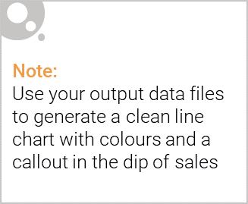
Older Singles/Couples, Retirees and Older Families are the highest purchasers of Chips products.
Older Singles/Couples contribute to about 21% of the total sales revenue as well as the chips quantity purchased.
Retirees are a close second with their 19% contribution to both areas.
Finally, Older Families make up about 18% of the total sales and the amount of chips purchased.
Together, they alone form approximately 58% of the total customer demographic, and therefore, areas with more Older People, Families and Retirees should be our focus.

Slide 6

Factoring in the affluence of the customers, Budget Older and Young Families, as well as Mainstream Retirees and Young Singles/Couples, are the most frequent buyers of the Chips products.
The number of Premium, Mainstream, as well as Budget customers seems almost equally distributed.
However, the majority fall into the Mainstream category with about 39% contribution to sales, followed by Budget customers (35% sales contribution) and lastly, the Premium customers with only about 26% contribution.
Therefore, brand and price generally play a higher role in the customer’s choice than the quality. Hence, it is recommended to keep more quantity of mid-priced and smaller packet sizes (130g – 175g) from well-known companies, like Kettle, Smiths, Doritos and Pringles.

Slide 7
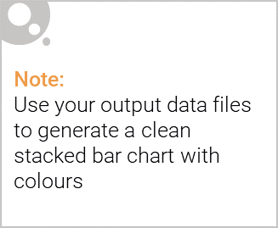
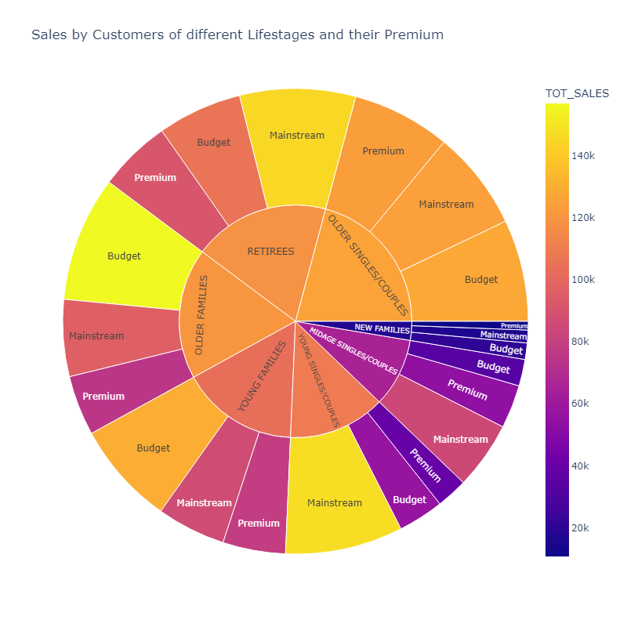
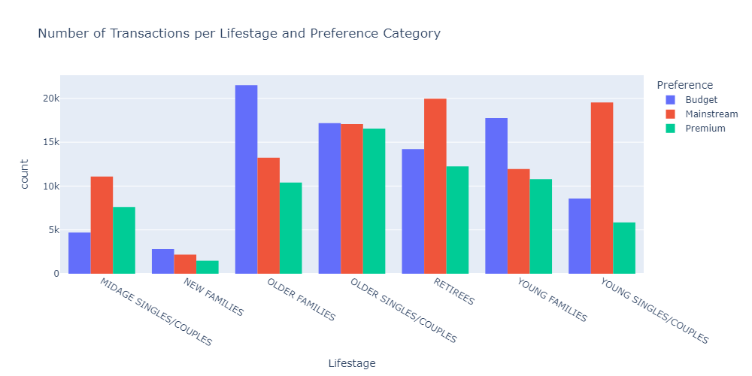
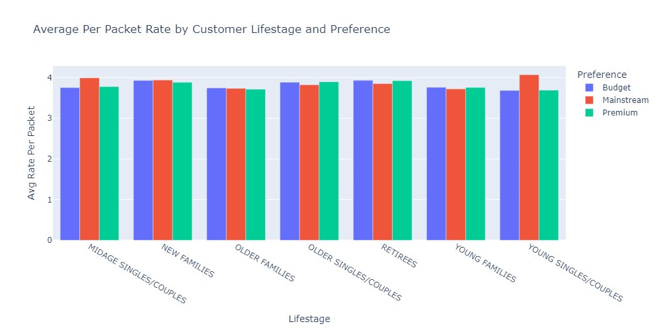
Editable (delete this)
Customer Demographic

Slide 8
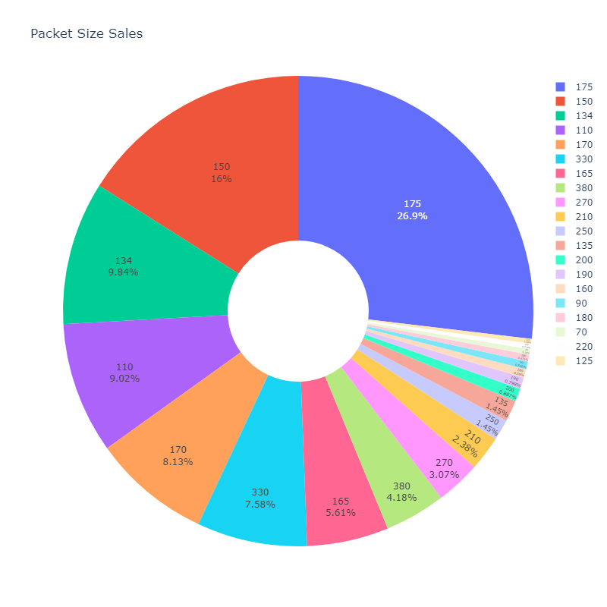
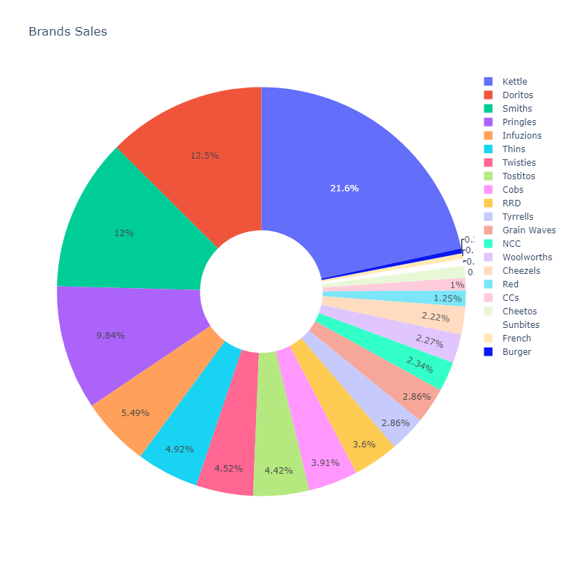
Editable (delete this)
Influence of Packet Sizes and Brands

Slide 9
02
Trial store performance

Slide 10
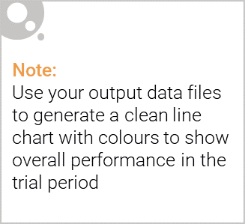
Stores 233, 155 and 91 were chosen as control stores for the test stores 77, 86 and 88, respectively.
Control stores are chosen based on several performance metrics like:
Monthly overall sales revenue
Monthly number of customers
Monthly number of transactions per customer
These control stores are chosen such that their performance based on these metrics are similar to that of the trial stores before the trial period starts.
Then, during the trial period, they are used to compare the expected as well as observed performance of the test stores to determine if the changes made had a significant impact or not.

Slide 11
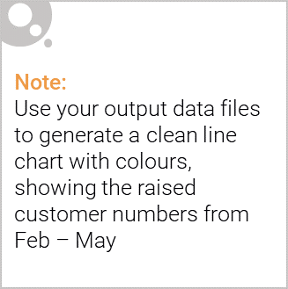
The new trial layouts seemed to be a success!
The new trial layouts seemed to have led to a significant increase in sales and number of customers, making it a successful venture.
A remarkable increase in sales as well as the number of customers can be seen during the month of March, 2019 in Store 86. Any special offers or changes in the store have resulted in a great success and should be investigated to see if they can be of further benefit.
On the contrary, a significant drop can be noticed in the sales and number of customers in Store 88, during the month of May, 2019. The reasons should be investigated in detail and suitable actions must be taken.

Slide 12
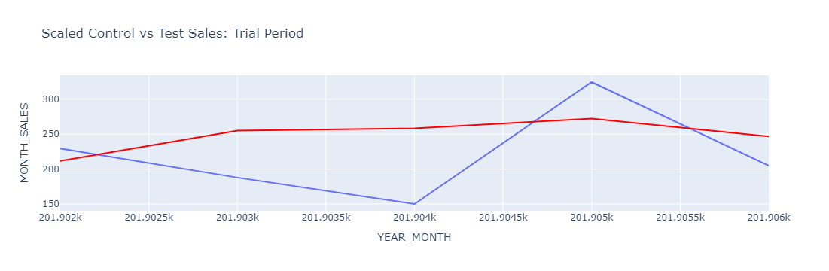
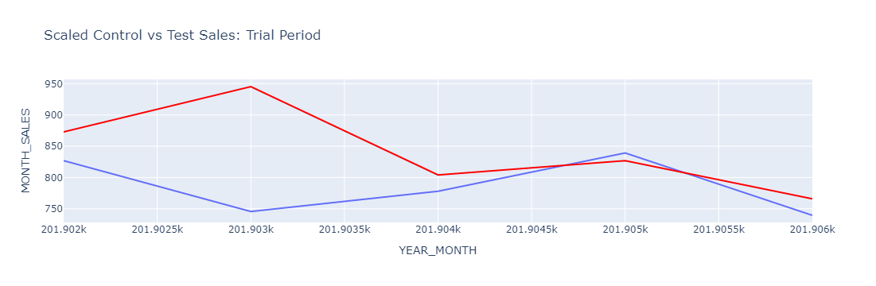
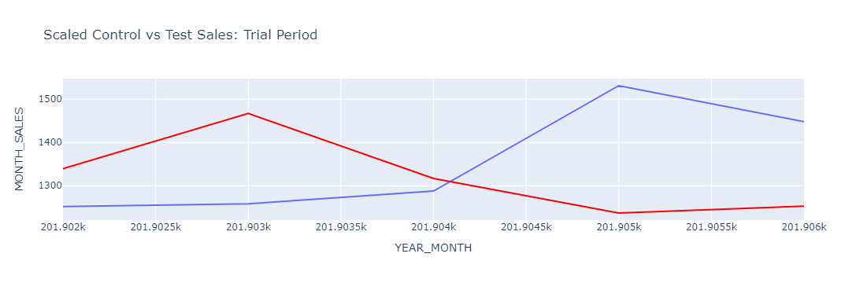
Trial Store Performance (indicated in red)
Store 77:
Store 86:
Store 88:

